Slide 1

DEPARTMENT OF MECHANICAL ENGINEERING
B.E PROJECT SEMINAR
ON
DESIGN AND DEVELOPMENT OF MINIATURE HEXAPOD
Guided by
Dr. Pradip Patil
In Collaboration with
BARC, India
Presented by :
Rohit Voleti (111A6064)
Bijoy Ramakrishnan (112A6002)
Gokul Mohandas (112A6007)
Rojenkoshy John (112A6009)

Slide 2
OVERVIEW OF THE PRESENTATION:
Sr.No | Contents | Slide No.
1. | Introduction to Hexapod | 3
2. | Objectives | 4
3. | Methodology | 5
4. | Problem Definition | 6
5. | Constraints in Design | 7
6. | Modelling Tree Diagram | 8
7. | Component Models & Design Criteria | 9
8. | Component Analysis | 17
9. | MATLAB Program & Solution | 27
10. | Conclusion | 34
11. | Future Scope | 35
12. | Bibliography | 36

Slide 3
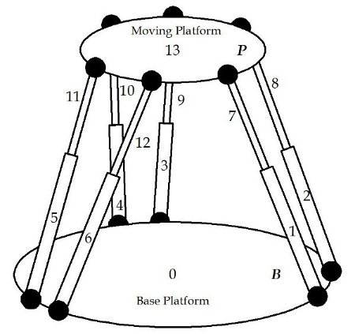
INTRODUCTION:
Hexapod is a type of Parallel robot manipulator that incorporates six prismatic actuators.
Devices placed on the top plate can be moved in the six degrees of freedom which makes it possible to move a freely-suspended body.
Applications:
- Flight Simulators
- Air-to-sea Rescue
- Satellite Dish Positioning
- Telescopes
- Underwater Research
- Machine Tool Positioning
- Crane Technology
- Orthopaedic Surgery.

Slide 4
PROBLEM DEFINITION
The Full-Scale Hexapod production is complicated and expensive and not feasible for low load applications
To design a miniature hexapod which is less expensive and can be comfortably used in such scenarios
Simulating & Testing of Miniature Hexapod for observing the effects of scaling down the Full-Scale model

Slide 5
OBJECTIVE
To design the various components of Miniature Hexapod for the given load and generating a CAD model
Testing these components for various modes of failure
Performing static and dynamic analysis using software
Evaluating results based on calculations & comparing calculated results with output obtained through simulation.
Obtaining maximum load that can be sustained within the permissible deflection limits.

Slide 6
METHODOLOGY
Design and selection of various components like actuator, housing, ball screw, motor, hinge etc.
Generating CAD model using SolidWorks/Creo 3.0 Software
Static and Dynamic Analysis of the system using ANSYS
Simulation of Miniature Hexapod Assembly using MATLAB
Validating software results with theoretical results.

Slide 7
CONSTRAINTS IN DESIGN
Part-Part | Motion required | Type of constraint used
Base plate | nil | DEFAULT
Base plate- Hinge | - | RIGID
Knuckle-Yoke | 1 DOF-rotation | PIN
Yoke-Block | - | RIGID
Block-Yoke | - | RIGID
Yoke-knuckle | 1 DOF- rotation | PIN
Knuckle-Actuator base plate | - | RIGID
Actuator base plate-motor | - | RIGID
Actuator base plate-housing | - | RIGID
Motor-Spline shaft | 1DOF-rotation | PIN
Spline shaft-Nut | 1 DOF-linear | SLIDER
Nut-Nut shell | - | RIGID
Nut shell –Knuckle | - | RIGID
Knuckle-Yoke | 1 DOF-rotation | PIN
Yoke-Block | - | RIGID
Block-Yoke | - | RIGID
Yoke-Knuckle | 1 DOF- rotation | PIN
Knuckle-Top plate | 6 DOF | GENERAL

Slide 8
MODELLING TREE
Linear Actuator
Housing
Actuator baseplate
motor
coupling
Ball screw
Spline shell
nut
Spline shaft
Actuator
Motor
gearbox
hinge
Knuckle
Yoke
Center block
yoke cap
HEXAPOD
Baseplate
Top-plate

Slide 9
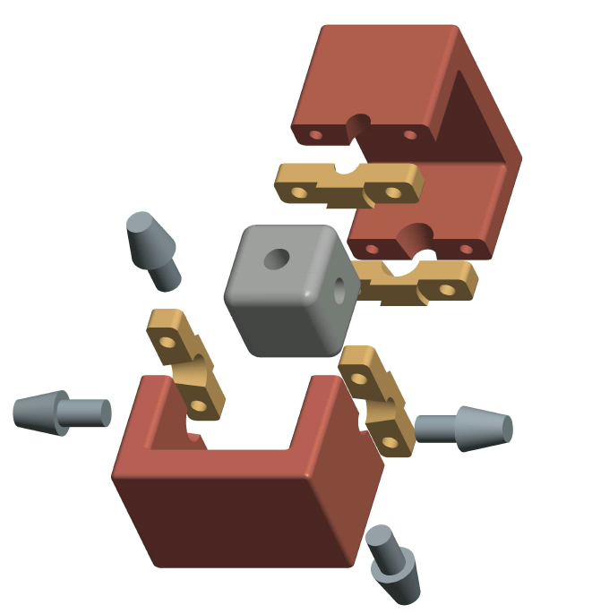
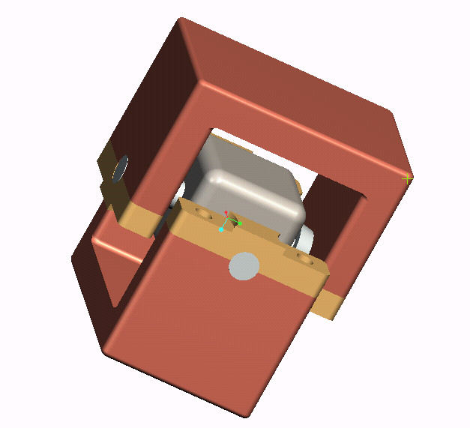
HINGE JOINT MODEL

Slide 10
HINGE JOINT ANALYSIS:
Material Selection: Corrosion resistant alloy steel and Nickel based coating
Components:
  Yoke – Crushing & Shear
  Clamp – Shear
  Hinge Body – Shear
Grid independency: Satisfied & Validated using ANSYS

Slide 11
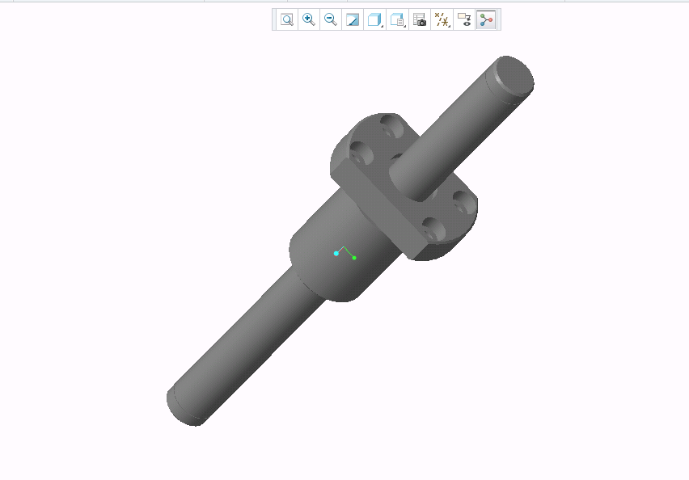
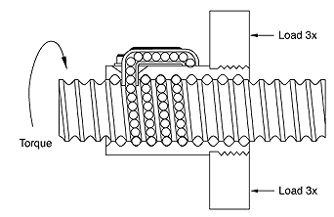
BALL SCREW MODEL

Slide 12
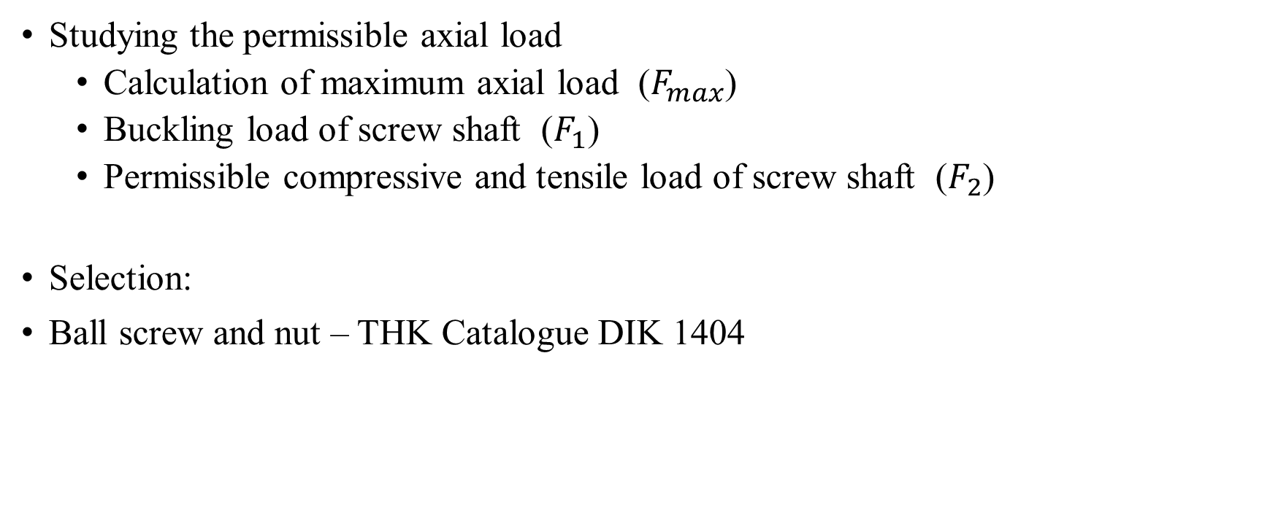
BALL SCREW SELECTION
Studying the permissible axial load
  Calculation of maximum axial load ($F_{max}$)
  Buckling load of screw shaft ($F_{1}$)
  Permissible compressive and tensile load of screw shaft ($F_{2}$)
Selection:
Ball screw and nut – THK Catalogue DIK 1404

Slide 13
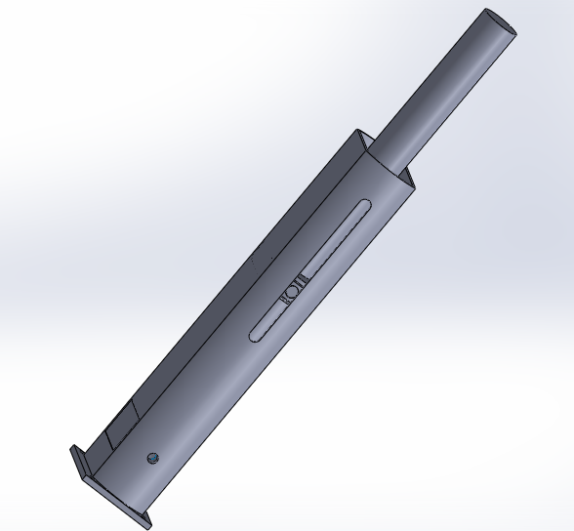
ACTUATOR MODEL

Slide 14
ACTUATOR DESIGN:
COMPONENTS:
Ball screw and nut – THK Catalogue DIK 1404
              Size & Load parameters
Motor selection - Maxon Motors DCX14L
              Velocity & Torque
Housing – Aluminium (2 mm thickness)
Coupling – Muff Coupling
              Axial Misalignment
Screw shaft casing - Aluminium

Slide 15
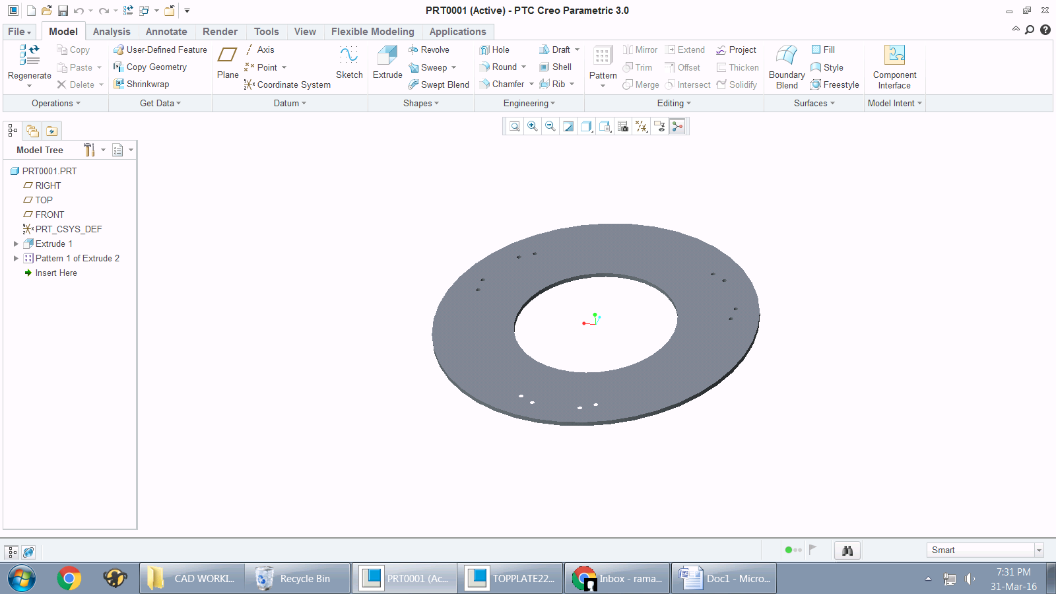
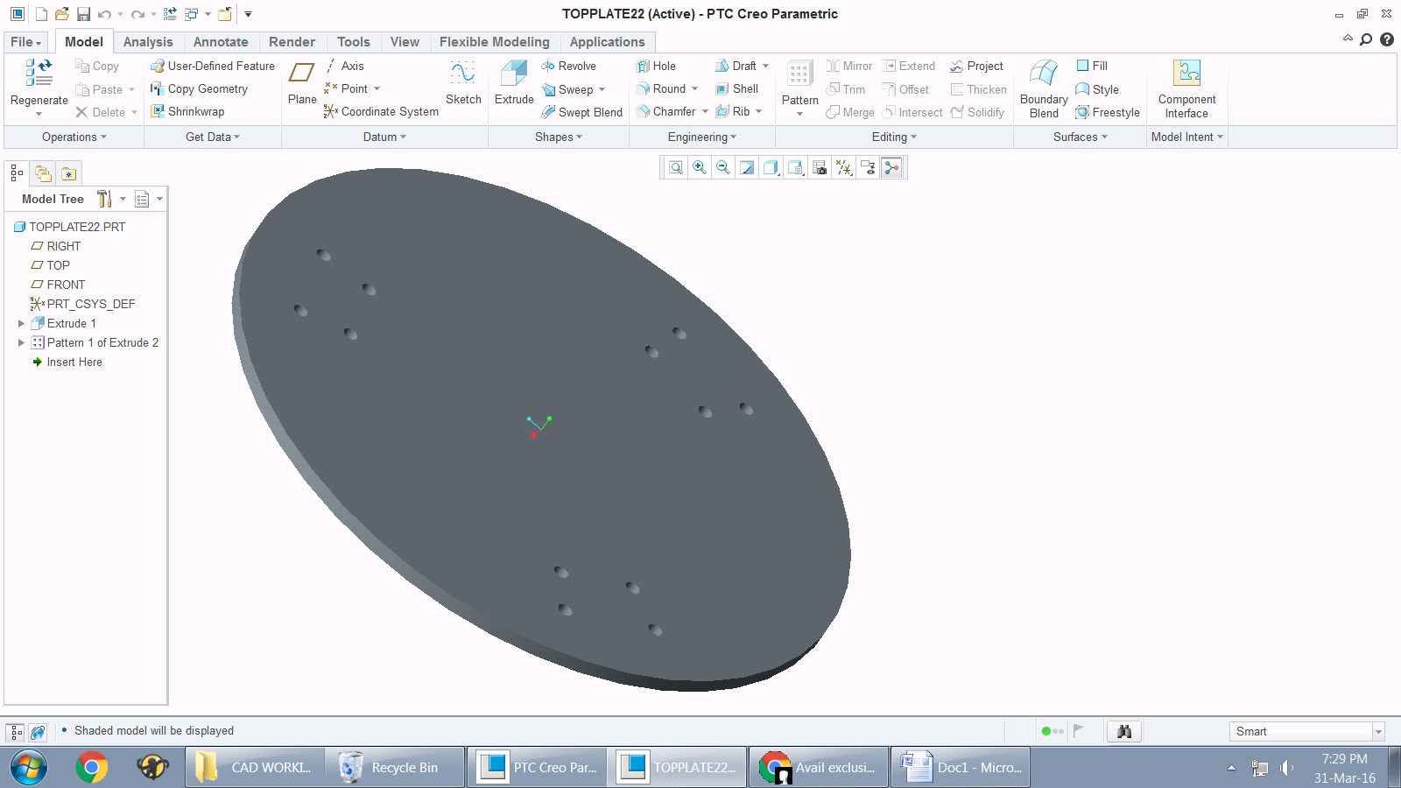
TOP & BASE PLATE
Baseplate - Sheet metal (gauge 6)

Slide 16
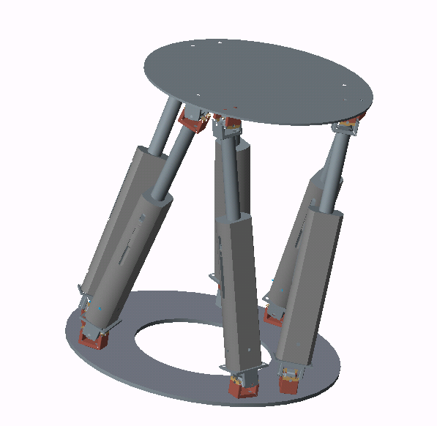
HEXAPOD MAIN ASSEMBLY

Slide 17
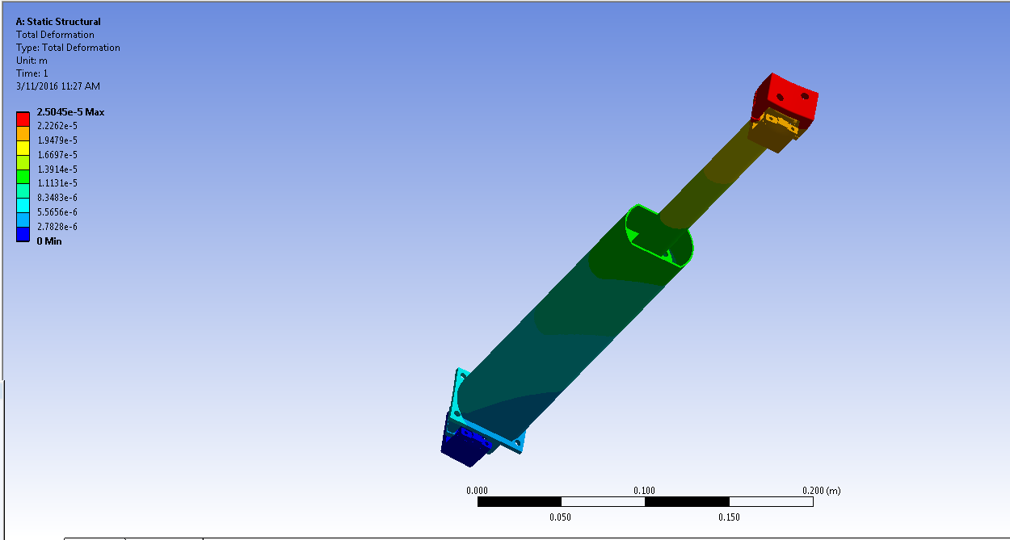

ACTUATOR DEFORMATION AT 300 N
$$Total Deformation=25.04 microns$$

Slide 18
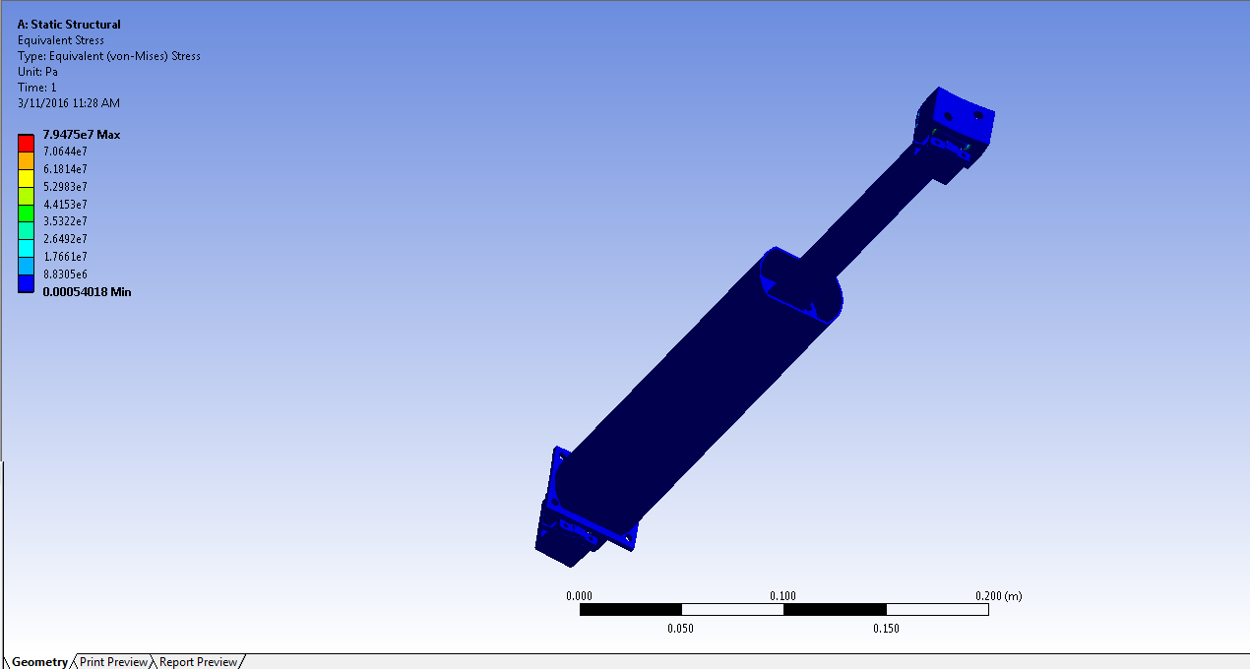

ACTUATOR STRESS AT 300 N
$$Max Equivalent Stress=79.47 MPa$$

Slide 19
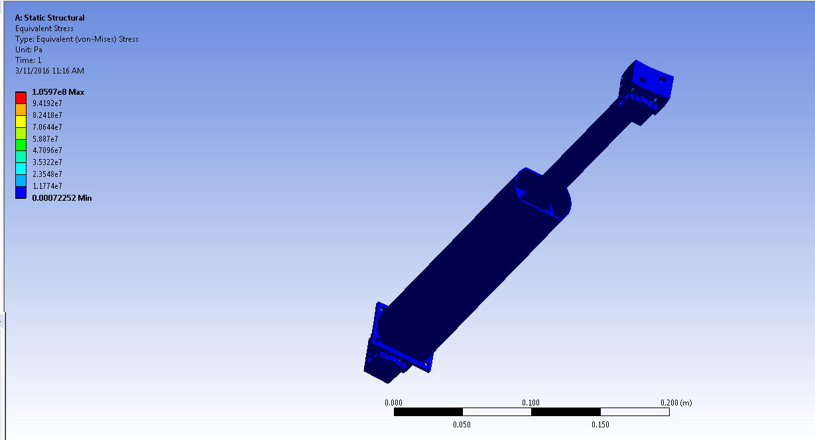

$$Max Equivalent Stress=105 MPa$$

Slide 20
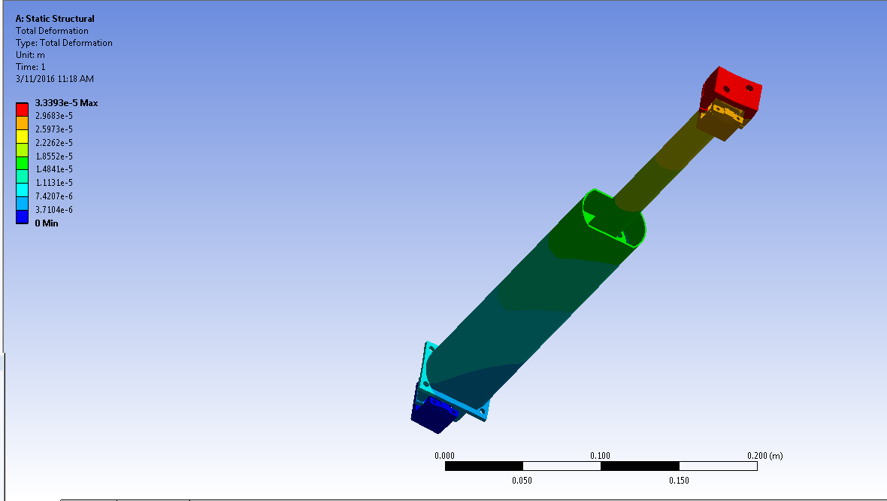

$$Total Deformation=33 microns$$

Slide 21
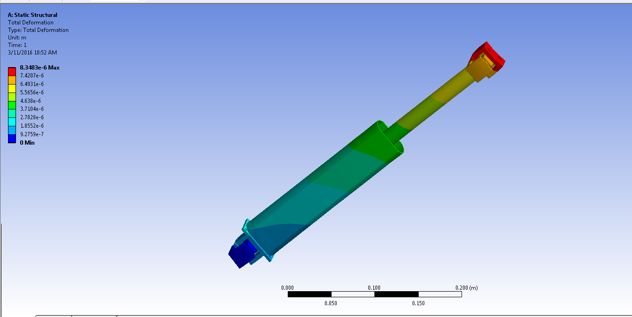
ACTUATOR DEFORMATION AT 100 N
$$Total Deformation=8.348 microns$$

Slide 22
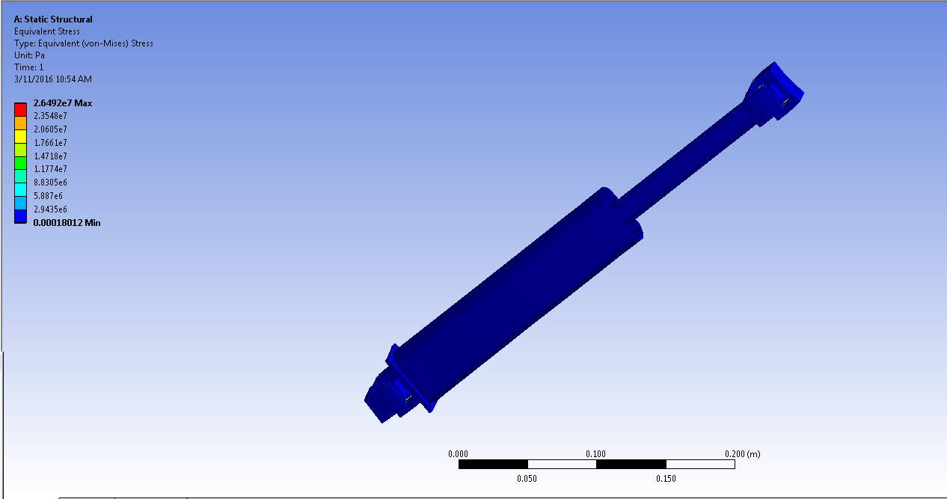

ACTUATOR STRESS AT 100 N
$$Max Equivalent Stress=26.49 MPa$$

Slide 23
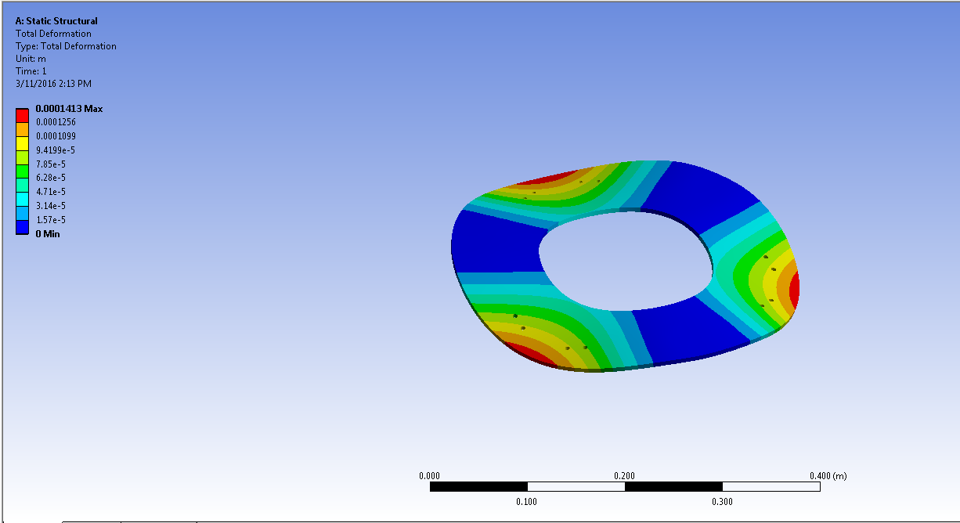

BASE PLATE DEFORMATION AT 125 kgf
$$Total Deformation=141.3 microns$$

Slide 24
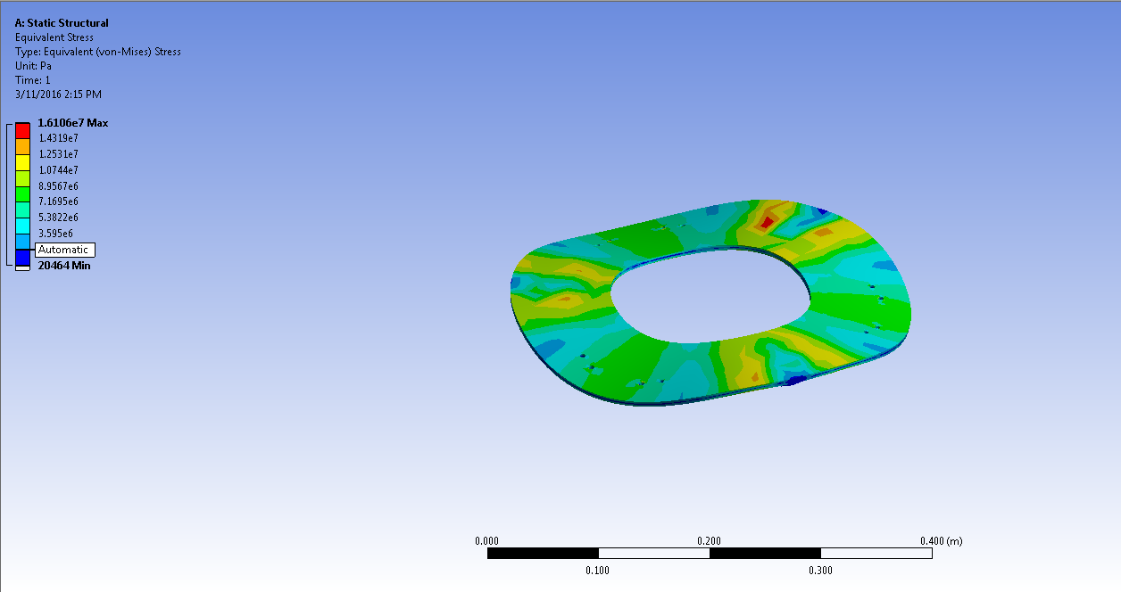

BASE PLATE STRESS AT 125 kgf
$$Max Equivalent Stress=16.10 MPa$$

Slide 25
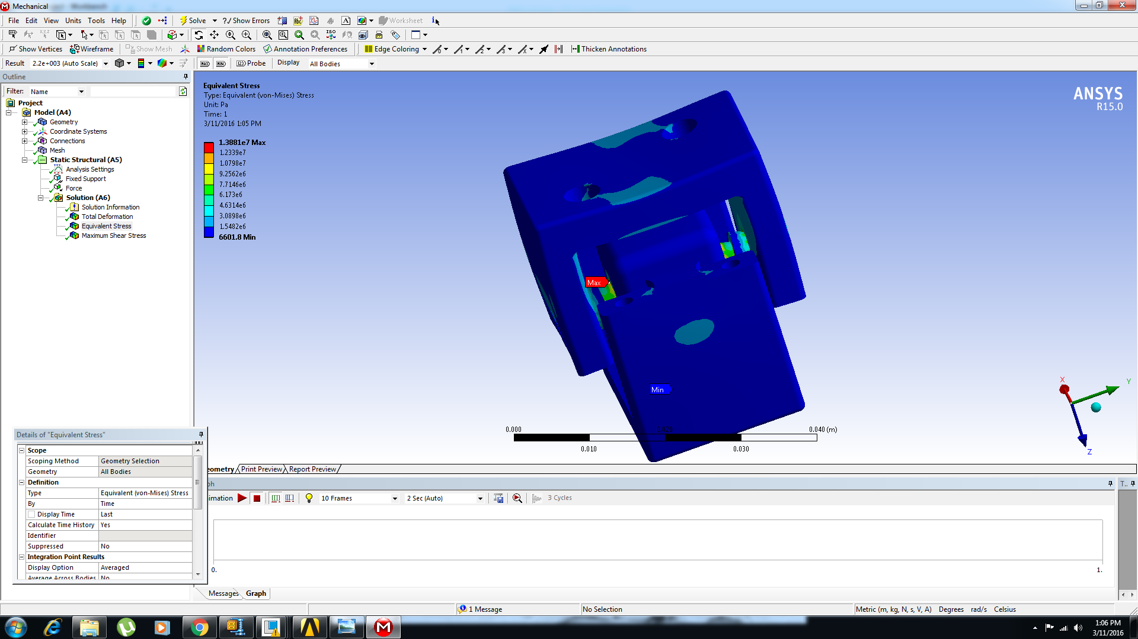

HINGE STRESS AT 100 N
$$Max Equivalent Stress=13.88 MPa$$

Slide 26
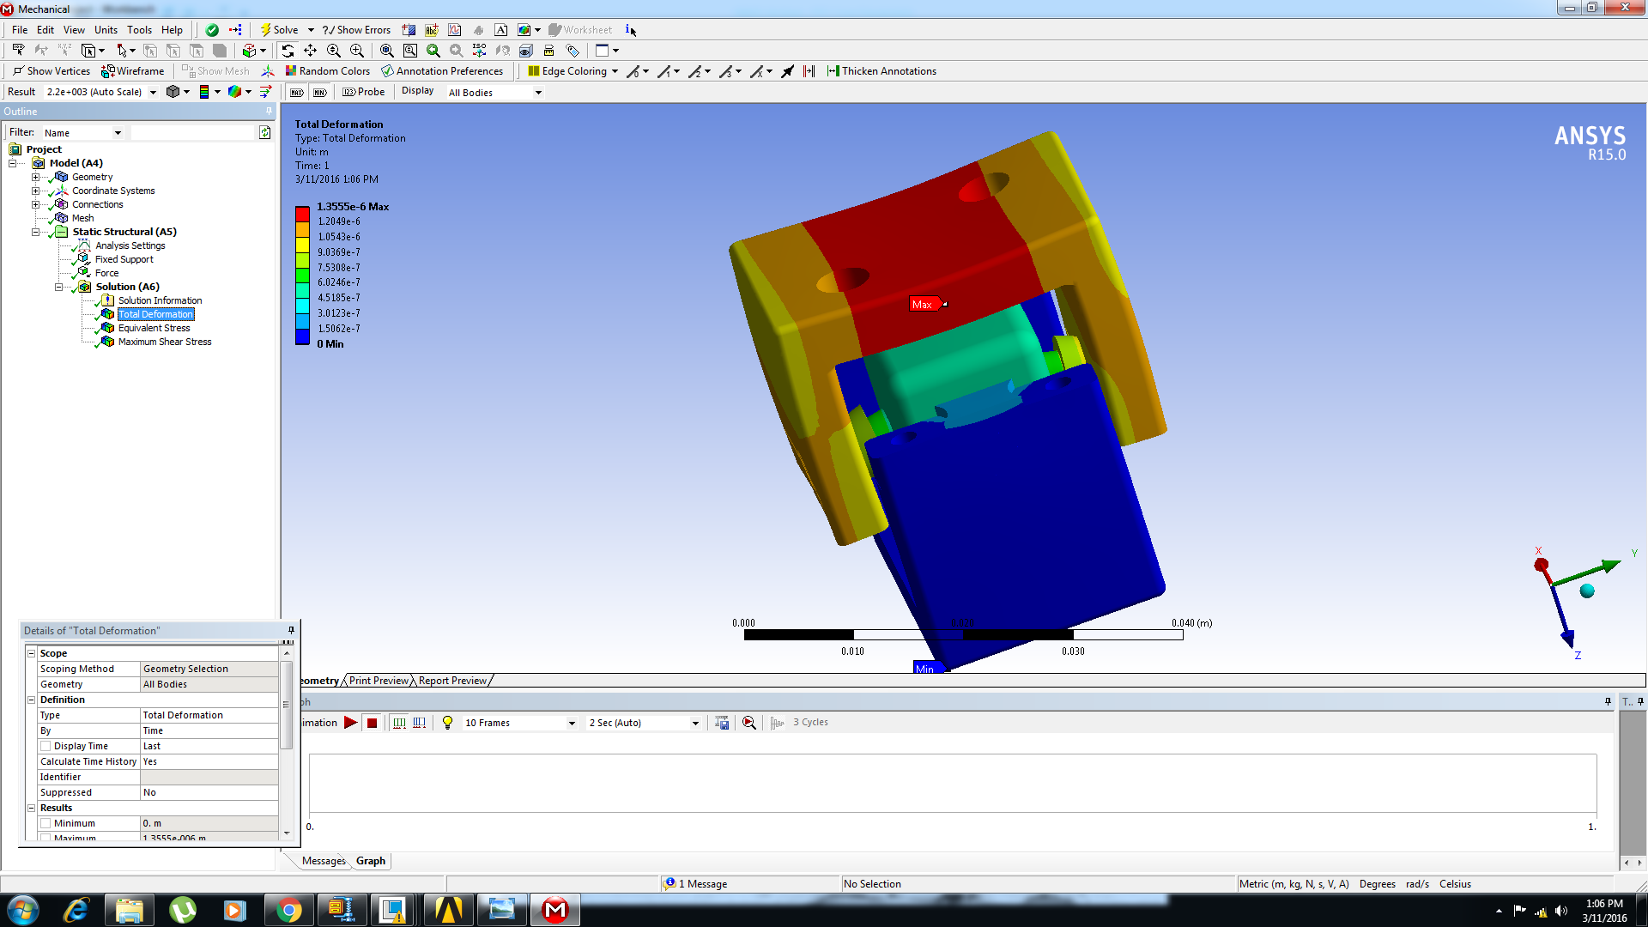

HINGE DFORMATION AT 100 N
$$Total Deformation=1.33 microns$$

Slide 27
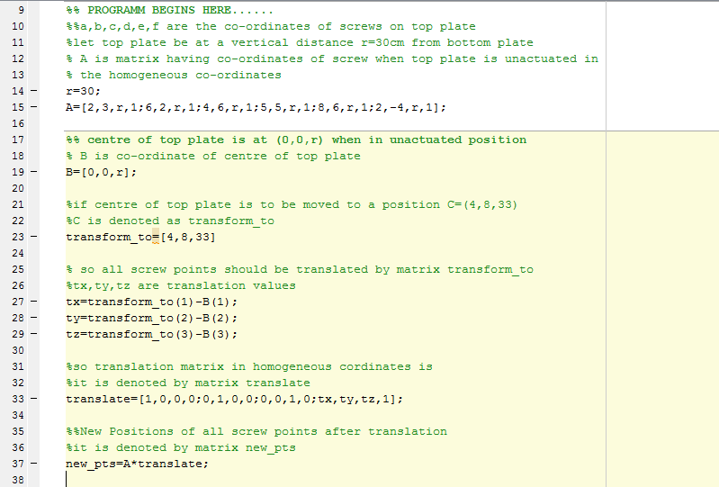
MATLAB PROGRAM

Slide 28
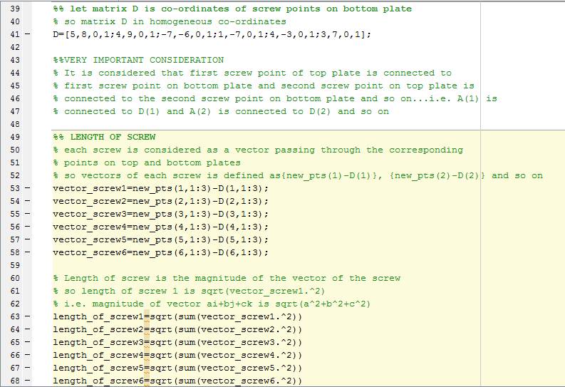

Slide 29
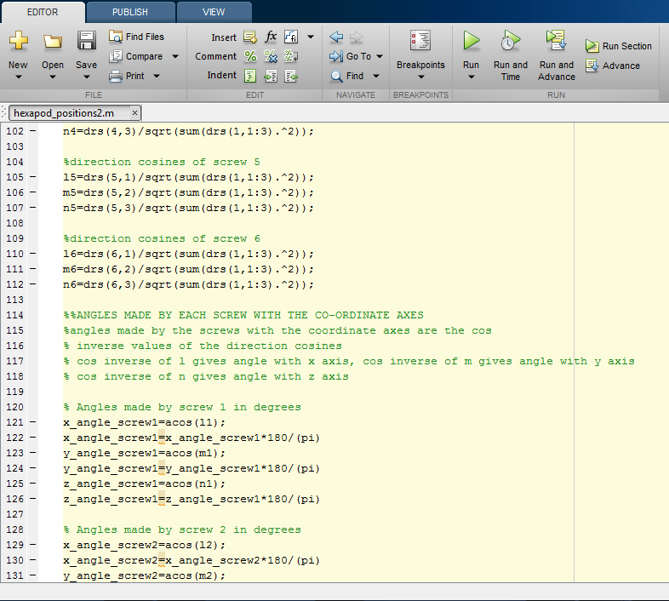

Slide 31
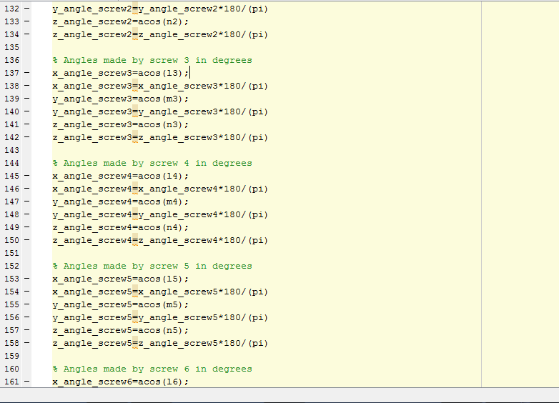
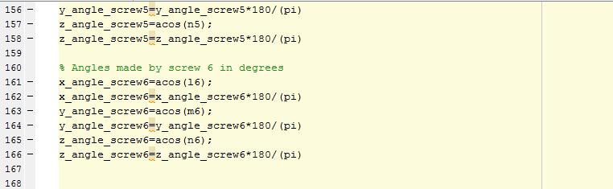

Slide 32
MATLAB SOLUTION:
>> hexapod_positions2
transform to =
4 8 33
length_of_screw1 =
33.1512
length_of_screw2 =
33.5559
length_of_screw3 =
41.4005
length_of_screw4 =
39.4081
length_of_screw5 =
37.9737
length_of_screw6 =
33.2716
x_angle_screw1 =
88.2714
y_angle_screw1 =
84.8079
z_angle_screw1 =
5.4737
x_angle_screw2 =
79.5726
y_angle_screw2 =
88.2714

Slide 33
z_angle_screw2 =
5.4737
x_angle_screw3 =
63.0976
y_angle_screw3 =
52.8936
z_angle_screw3 =
5.4737
x_angle_screw4 =
76.0356
y_angle_screw3 =
52.8936
z_angle_screw3 =
5.4737
x_angle_screw4 =
76.0356
y_angle_screw4 =
52.8936
z_angle_screw4 =
5.4737
x_angle_screw5 =
76.0356
y_angle_screw5 =
59.1493
z_angle_screw5 =
5.4737
x_angle_screw6 =
84.8079
y_angle_screw6 =
95.1921
z_angle_screw6 =
5.4737
>>

Slide 34
CONCLUSION
All the components of the Miniature Hexapod were successfully designed for a load of __ kN.
The assembly was simulated using MATLAB & Creo 3.0.
The maximum deflection of the whole assembly was well under 1 mm limit.
The maximum load capacity for 1mm deflection was found out to be__ kN.
In conclusion we can say that, a Miniature Hexapod can be developed for low load applications desiring high level positioning accuracy & balancing.

Slide 35
FUTURE SCOPE
Miniature Hexapod can be modified to do long distance remote surgery.
It can also be modified to accurate positioning of heavy artillery in military applications.
Its base plate can be further modified to be replaced by wheels or rollers to provide motion thereby can be used as a small all terrain remote vehicle.
By providing various modifications and improvement to the current design, the miniature hexapod finds profuse applications in all prominent engineering fields.

Slide 36
BIBLIOGRAPHY
[1] Gwinnett, J.E., "Amusement devices," US Patent No. 1,789,680, January 20, 1931.
[2] Cappel, K.L., "Motion simulator," US Patent No. 3,295,224, January 3, 1967.
[3] Gough, V.E. and Whitehall, S.G., "Universal tyre test machine," Proceedings of the FISITA Ninth International Technical Congress, pp. 117-137, May, 1962.
[4] Stewart, D., "A platform with six degrees of freedom," Proceedings of the IMechE, Vol. 180, Pt. 1, No. 15, pp. 371-385, 1965-66.

Slide 37
[5] Lazard D, Merlet J. P. (1994). "The (true) Stewart platform has 12 configurations". Proceedings of the 1994 IEEE International Conference on Robotics and Automation. p. 2160. doi:10.1109/ROBOT.1994.350969. ISBN 0-8186-5330-2
[6] Y. D. Patel , P. M. George Parallel Manipulators Applications—A Survey revised March 25, 2012; accepted April 2, 2012
[7] (CoRo-control and robotics laboratory) en.etsmtl.ca/Unites-de- herche/CoRo/Nous-joindre
[8] Hamid. D. Taghirad- PARALLEL ROBOTS :Mechanics and control (ISBN:978146655576)
[9] Bhaskar Dasguptaa, T.S. Mruthyunjaya -The Stewart platform manipulator: a review

Slide 38
[10] Topology and Geometry of Serial and Parallel Manipulators Xiaoyu Wang and Luc Baron, Polytechnique of Montreal Canada .(Parallel Manipulators, New Developments, Book edited by: Jee-Hwan Ryu, ISBN 978-3-902613- 20-2, pp. 498, April 2008, I-Tech Education and Publishing, Vienna, Austria)
[11] Feng Gao , Weimin Li, Xianchao Zhao, Zhenlin Jin, Hui Zhao , New kinematic structures for 2-,3-,4-,and 5- DOF parallel manipulator designs, Mechanism an Machine Theory 37 (2002) 1395 – 1411
[12] Grigore Gogu, Structural Synthesis of Parallel Robots Part 5 , Springer
[13] Tompkins, Eric (1981). The History of the Pneumatic Tyre. Dunlop. pp. 86, 91. ISBN 0-903214-14-8.
[14] Fraunhofer Research: Hexapod Robot for Spine Surgery
[15] Bonev, I.A., "The True Origins of Parallel Robots", Parallel MIC online review

Slide 39
THANKYOU !

