Slide 1
Thermally Actuated Flexure
PRECISION MACHINE DESIGN
Members: Michael Erickson
Chunjie Fan
Gokul Mohandas
Ameya Parab

Slide 2
Objectives
Evaluate load capacity of flexure to displace 1000N loads 100um
Achieve position control within 100 µm range under various loads
Thermally isolate the actuator.
Decrease the response time of the flexure.

Slide 3
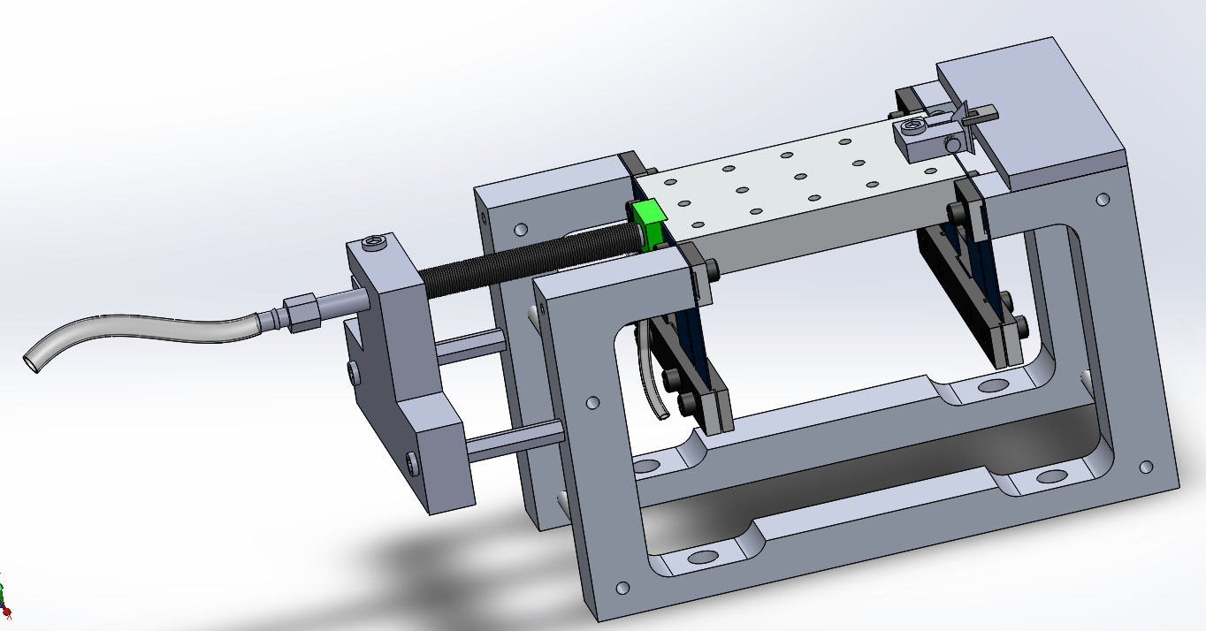
Original Design
Knife edge displacement sensor
Compound flexure, single degree of freedom
Heated aluminum tube actuator
Thermal isolation of actuator
PWM heater and water pump control
Aluminum frame susceptible to deflection during actuator expansion
Ni-Cr Coil
Knife holder
Knife
Aluminum tube actuator
Glass
Flexure table
Water cooling lines
Aluminum frame

Slide 4
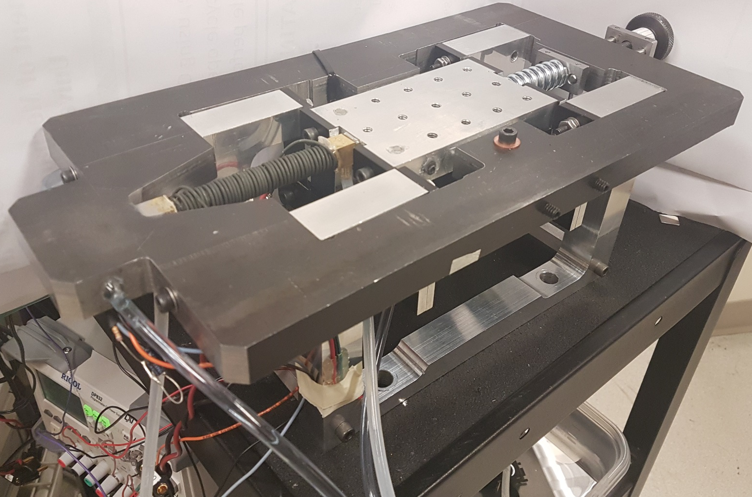
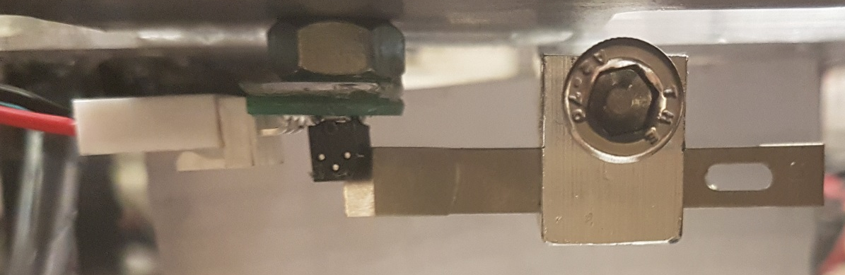
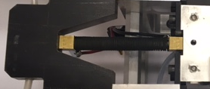
New design
Displacement sensor
Compression system
Ni-Cr Coil
Temperature sensor
Monolithic rigid steel frame
Load application compression system
Position guide pins for flexure table
Thermal isolation of actuator
PID heater and water pump control
Guide pins
Knife
(flexure motion)
Displacement sensor
Cooling lines

Slide 5
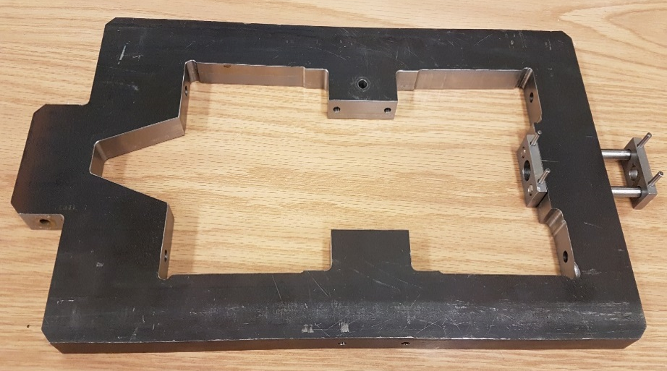
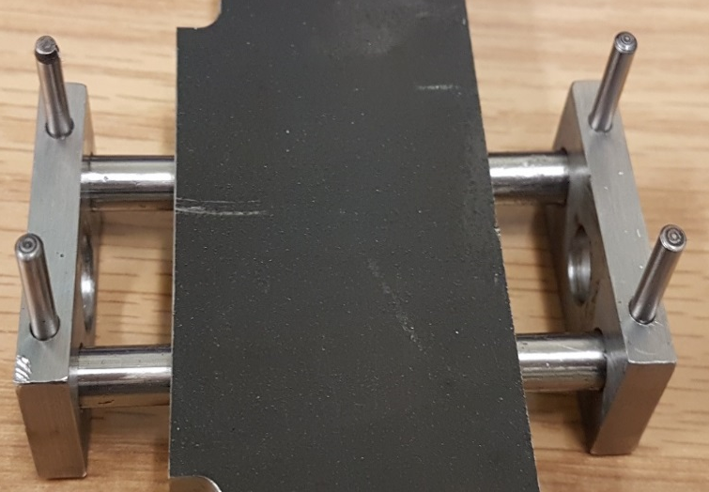
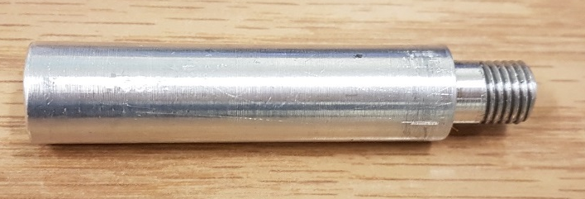
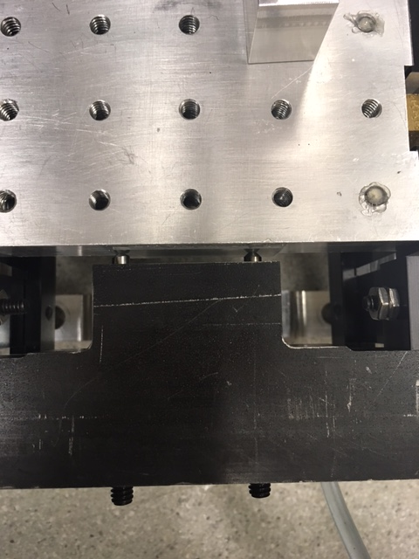
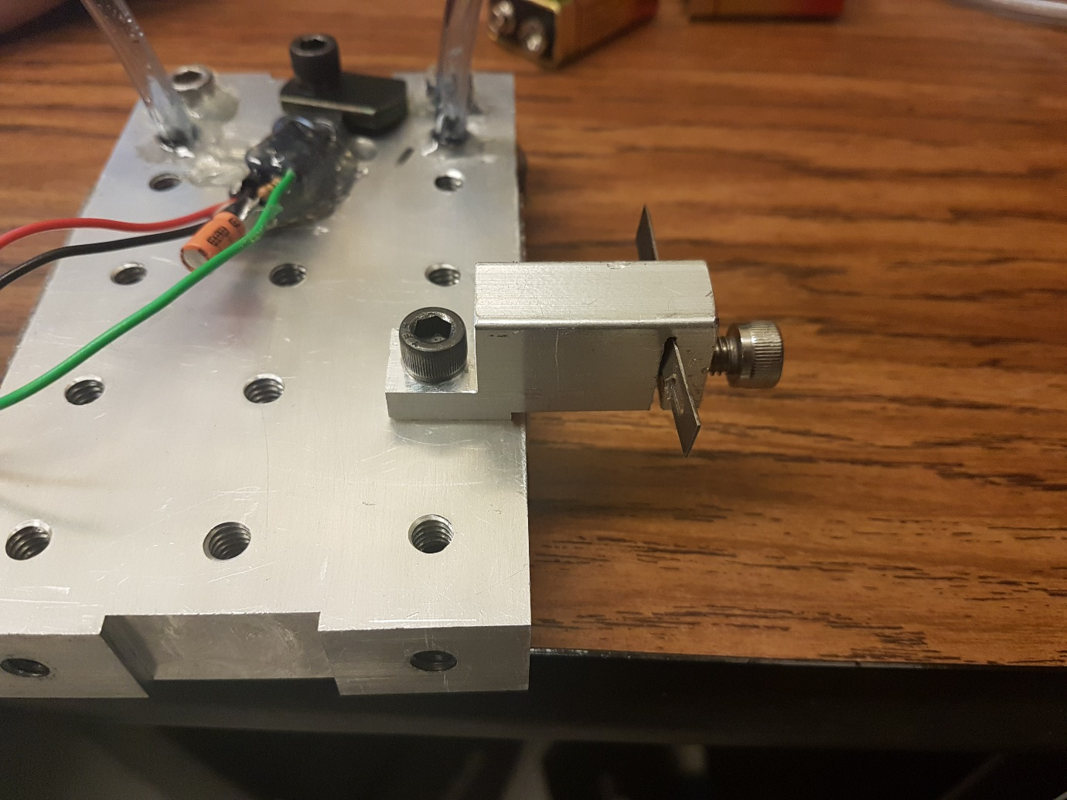
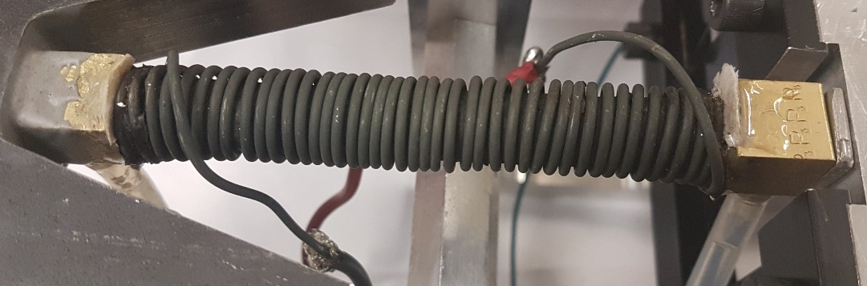
Manufacturing
1018 Steel frame
Compression system
Spring guide
Adjustable guide pins
Knife holder
Guide pins
Ni-Cr coil
Set screws

Slide 6
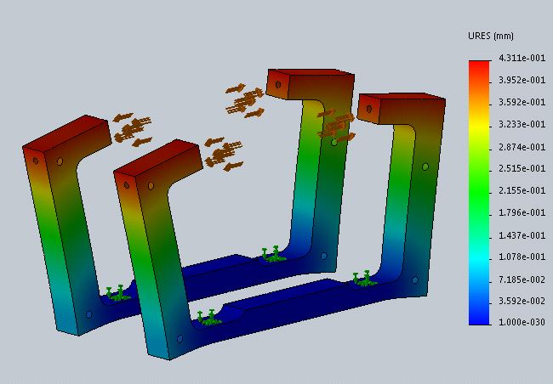
Deformation of original design
Base structure deflection with 1000N load
Maximum axial deflection = 431.1 µm

Slide 7
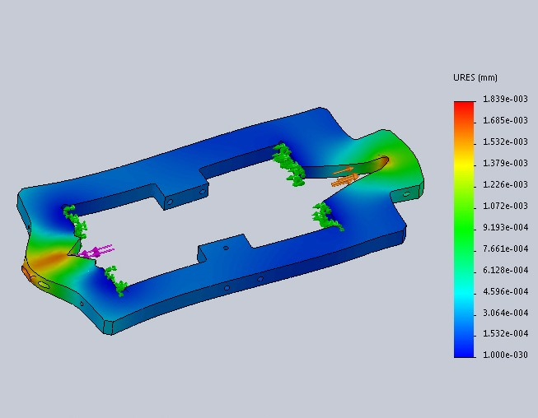
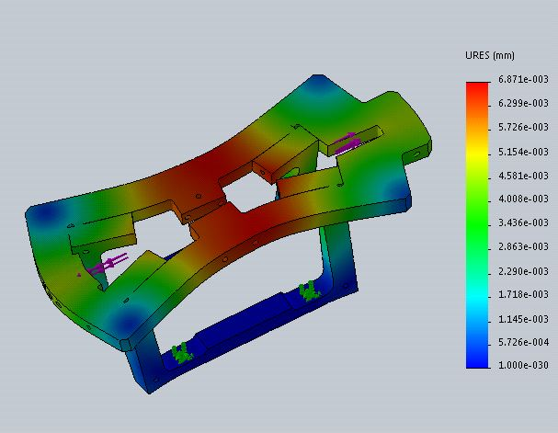
Frame deformation (Aluminum Vs Steel)
Frame deflection with 1000N axially along actuator
Frame only
Frame and base
Fixed
Fixed
Force
Force
Fixed base
Maximum axial deflection
6061 Aluminum 1.8 µm
1018 Steel 0.6 µm
Total axial deflection
1018 Steel 8 µm
1018 Steel was chosen from frame material

Slide 8
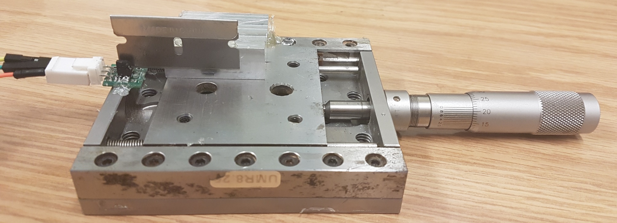
Optical sensor calibration
Displacement to voltage relationship
Micrometer displacement
5 um increments
300 um range
Micrometer
Optical sensor

Slide 9
Optical sensor calibration
Linear range over ~200 um
52:1 ratio

Slide 10
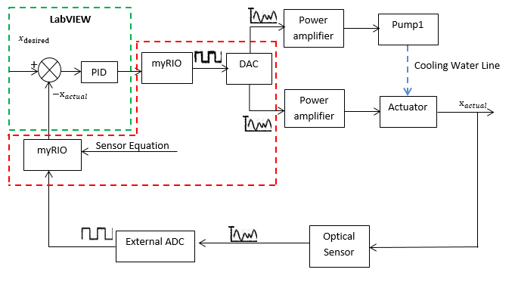
Control system flow chart

Slide 11
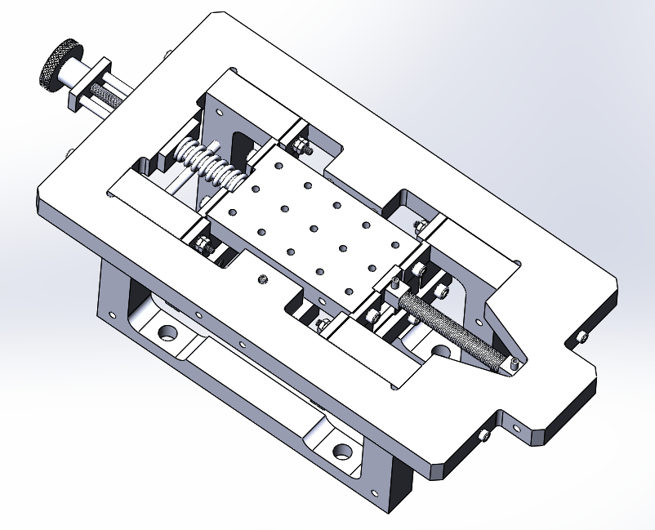
Test: 100um displacement
Applied force
Procedure:
Applied 0N – 1000N to flexure and displaced flexure stage by 100um under each load
Spring constant – 294 lb/in
Turns per inch – 24
1.8 screw rotations for 100N increase
Measurands:
Actuator’s force capability
Parameters:
Room temperature 23C
Results were peformed using cooling water flowing through actuator tube.
Boolean control of actuator 12V power supply
Actuator coil resistance ~1.5Ω
Flexure motion
Compression screw

Slide 12
Results: 100um displacement
Cooling water was flown threw actuator upon cooling
Applied force
Flexure motion
Compression screw
Heating 12V only
Cooling only
Heating time constants*
~0um – 100um
t_{0N} = 60s
t_{500N} = 55s
Cooling time constants
~0um – 100um
t_{0N} = 15s
t_{500N} = 25s
*Time constants are determined by heating initialization to 100um displacement.

Slide 13
Results: 100um displacement
Applied force
Flexure motion
Compression screw
Heating 12V only
Heating time constants* 0um-100um
t_{500N} = 60s
t_{1000N} = 65s
*Time constants are determined by heating initialization to 100um displacement.

Slide 14
Test: Thermal isolation of actuator
Procedure:
Under 200N displaced at 100um, evaluated temperature of flexure stage and frame
Measurands:
Temperature of the flexure stage
Temperature of frame surrounding actuator
Parameters
Applied load 200N
Flexure stage displaced ~0um – 100um
Room temperature 23C
Table temp
Frame temp
Heat source
Cooling water

Slide 15
Test: Thermal isolation of actuator
Table temp
Frame temp
Heat source
0um
100um
Room temperature
23°C
Increase in frame temp
0.4212°C
Increase in table temp
0.5188°C
Cooling water

Slide 16
Test: Positional control and stability
Procedure:
Under 100N, 500N, and 1000N flexure stage was displaced to commanded positions are held steady for a time
Measurands:
Flexure stage position
Error
Parameters
Cooling achieved using 4”x4” box fan targeted at coil
(no cooling water was used through actuator)
Room temperature 23C
Force
Displacement
Heat

Slide 17
Results: 0N Positional control and stability

Slide 18
Results: 500N Positional control and stability

Slide 19
Results: 1000N Positional control and stability

Slide 20
Results: 1000N zoom at 50um
Average error
error = (-)0.33 um

Slide 21
Heating time constants for 0um to 30um displacement
Time constants
~0um – 30um
t_{0N} = 235.2s
t_{500N} = 578.6s
t_{1000N} = 535.1s
Time constants for error = 10%
Reason why t_{1000N} < t_{500N} may be friction on flexure stage from guides pins
Desired = 25um

Slide 22
Bill of materials, mechanical
 | Item | Description | Material | Total Cost
Frame | Steel Plate | 0.75’’ thick, 8’’x24’’, 2 ft. length | 1018 steel plate | 133.01
 | Screw | Fastening actuator side for frame, 10-24 thread,5"1/2" lg. | Black-Oxide Alloy Steel | 6.38
 | Screw | Fastening spring side of frame, 10-24 thread, 4 3/4" length | Black-Oxide Alloy Steel | 5.92
 | Washer | Flat type washer with ID 0.203", OD 0.438", Thickness 0.024"-0.038" | 316 Stainless Steel | 4.24
 | Hex Standoff | 5/8'' OD, 1/4''-20 , 3 1/2" length, Female thread | 2011 Aluminum | 3.36
 | Nut | 10-24, 1/8" thick, pack of 100 | 18-8 Stainless Steel | 3.50
Actuator | Steel drive tube | NPT Male Threaded on Both Ends, 1/8 Pipe Size, 4" Long | 304/304L Stainless Steel | 3.18
 | Aluminum drive tube | NPT Male Threaded on Both Ends, 1/8 Pipe Size, 4" Long | Aluminum | 2.08
 | Brass hose barb | 1/8 FNPT, 1/4" tube size, barbed, 90deg elbow | Brass | 17.36
 | Guide rods (flexure stage) | 0.1990" OD 3 ft. 6 ft. | Tool Steel | 6.50
 | Set screws | Oval tip, 1/4''-20 thread size, 1'' length, Hex Coarse thread set screws | Alloy Steel | 10.17
 | Guide pins (compression screw) | 1/4" OD, 3'' length, dowel pin | Hardened Alloy Steel | 8.03
 | Knurled-Rim Knob | 5/16"-24 x 1-3/4" Threaded Stud, 1-1/2" Diameter | Black-Oxide Steel | 5.59
 | Compression Spring | Zinc-Plated, Music-Wire, Closed & Flat Ends, 2" Long, 3/4" OD, 294 lb/in | Zinc-Plated Music-Wire Steel | 17.61

Slide 23
Bill of materials, mechanical and electrical
 | Item | Description | Material | Total Cost
Actuator | Steal bar stock | 1/4" thick, 3/4" wide, 2 ft. length rectangular bar | Low-Carbon Steel | 20.34
 | Aluminum shaft stock | 15" OD (for spring guide) | 6061 Al
 | Ni-Cr wire | 0.064" Diameter, 1/4 lb. Spool, 21' Long | Nickel Chromium | 21.28
Cooling and isolation | Round Seal | O-Ring Cord Stock, 1/4" OD, 3' length. | Neoprene Rubber | 1.65
 | Plastic tubing | Durometer 50A, 1/8" ID, 1/4" OD, 375F, 10ft | Silicone Rubber | 6.9
 | Plastic tubing | Cooling Pipes | PVC | -
 | Glass | For low friction surface for guide rods against flexure | Glass | -
Controls | myRIO | Controller | - | -
 | 16 bit ADC | Analog to Digital Converter | - | -
 | 12V 10A power supply | TDK Lambda | - | -
 | Power amplifier | Amplifier | - | -
 | ± 12 V Power supply | RIGOL Power Supply | - | -
 | Temperature sensors | LM 35 | - | -
 | Optical Sensor | RPI 0352E | - | -
 | TOTAL |  |  | $ 277.10

Slide 24
Project milestones
Objective | Start date
Evaluate current design, finalize dimensions and material specifications | Sunday March 9th
Order materials | March 20th
Frame Manufacturing | April 6th
Assemble new design | April 17rd
Testing, calibration, modifications | April 24th
Final Results | May 1st, 2017
Final Presentation | May 4th, 2017

Slide 25
Future improvements
Increase compression force
Fine tune controller
Create improved method to mount actuator
More sensitive pumps; more controllable flow
Improve electrical isolation between Ni-Cr wire and actuator tube

